Slide 1


Labmentix
Project Title - Instagram Performance Analytics for Sugar Cosmetics
Name - Chama Kaushik
Domain - Data Analyst
Batch - DA/BA 15 August
Year - 2025

Slide 2
Project Overview
Project Objective
To analyze Sugar Cosmetics’ Instagram performance using data analytics.
Build an interactive Power BI dashboard to track content trends, audience engagement, and brand growth.
Identify actionable insights to optimize posting strategy and improve engagement rate.
Dataset Summary
Dataset Name: sugar_cosmetics_instagram_data
Total Records: ~ 50 K
Columns (9): post_date, post_type, likes, comments, shares, saves, reach, impressions, hashtags
Tools & Techniques Used
Power BI – Dashboard creation & data visualization
DAX – KPI calculation and performance measures
Power Query – Data cleaning & transformation
Analytical Methods - Trend analysis, engagement funnel, post-type comparison

Slide 3
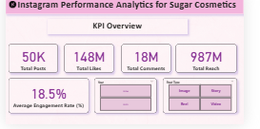
Key Metrics (KPIs) | Overall Instagram Summary
Sugar Cosmetics maintains a strong Instagram presence with 50K posts and a reach of 987 million.
The brand generated 158 million likes and 18 million comments, achieving an impressive 18.5% engagement rate.
These results reflect a highly active and engaging community around the brand.

Slide 4
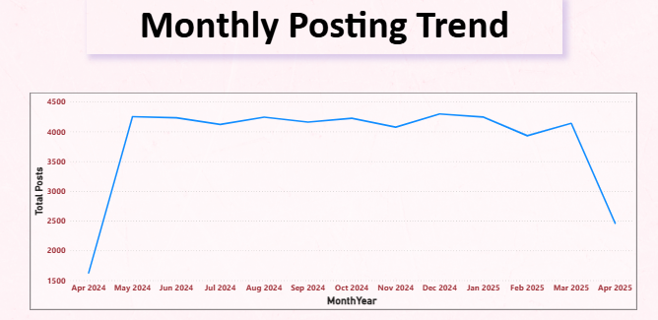
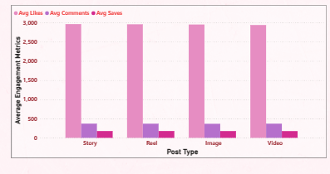
Posting & Content Insights | Trends and Post Performance
Sugar Cosmetics maintained a consistent posting trend, averaging around 4K posts per month throughout the year.
A slight drop was observed in April 2025, indicating a possible pause in campaigns or posting schedule.
Among post types, Video and Carousel posts received the highest average likes, comments, and saves, highlighting audience preference for interactive and visual-rich content.
Image posts performed comparatively lower, suggesting a need to focus more on engaging formats like Reels and Carousels.

Slide 5
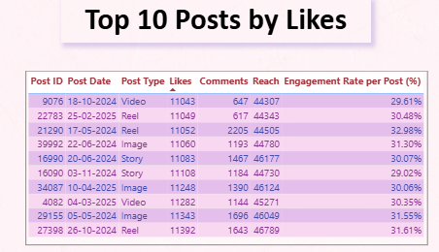
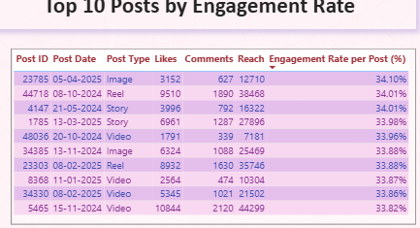
Top Performing Posts | Likes vs Engagement Rate
The Top 10 Posts by Likes are mainly Videos and Reels, showing strong audience preference for short, dynamic content.
Posts featuring Reels achieved engagement rates above 32%, highlighting their ability to drive active interactions.
The Top 10 by Engagement Rate includes a mix of Videos, Stories, and Reels, suggesting variety also keeps audiences engaged.
Overall, video-based content delivers the highest engagement, making it the most effective format for Sugar Cosmetics’ Instagram strategy.

Slide 6
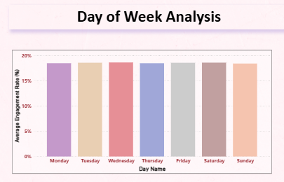
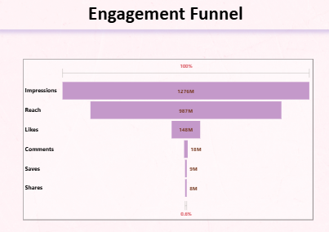
Audience Behavior Insights | Engagement by Day & Funnel
Engagement remains steady across the week, averaging around 18.5% overall.
Wednesday (18.63%) shows the highest engagement, followed closely by Saturday and Tuesday.
The Engagement Funnel reveals a big drop from Reach (987 M) to Likes (148 M) and Saves (9 M).
This indicates high visibility but low deeper actions—suggesting a need for more interactive, save-worthy content like tutorials or Reels.

Slide 7
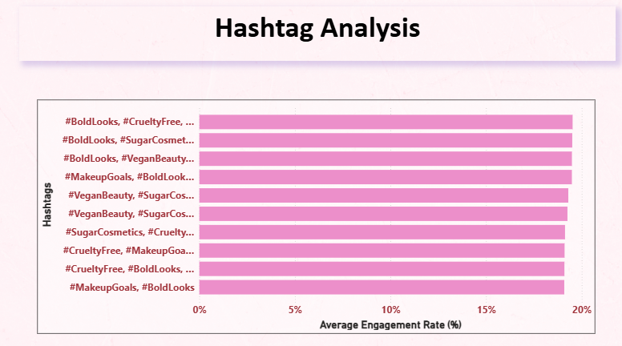
Hashtag Analysis | Top Hashtags Performance
The top hashtags used by Sugar Cosmetics consistently show strong engagement rates, mostly around 18–19%.
Hashtag combinations like #BoldLooks, #CrueltyFree, #SugarCosmetics, and #VeganBeauty perform the best across posts.
Posts with branded and niche beauty hashtags drive better interaction than generic ones.
This suggests the brand should continue using focused, relevant hashtag groups to maintain high engagement

Slide 8
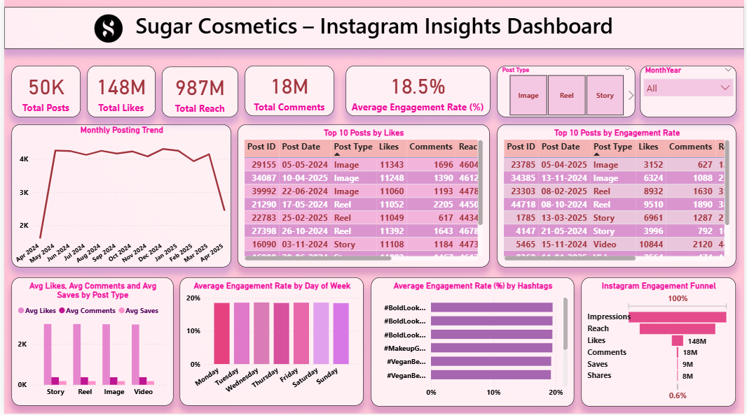
Final Dashboard

Slide 9
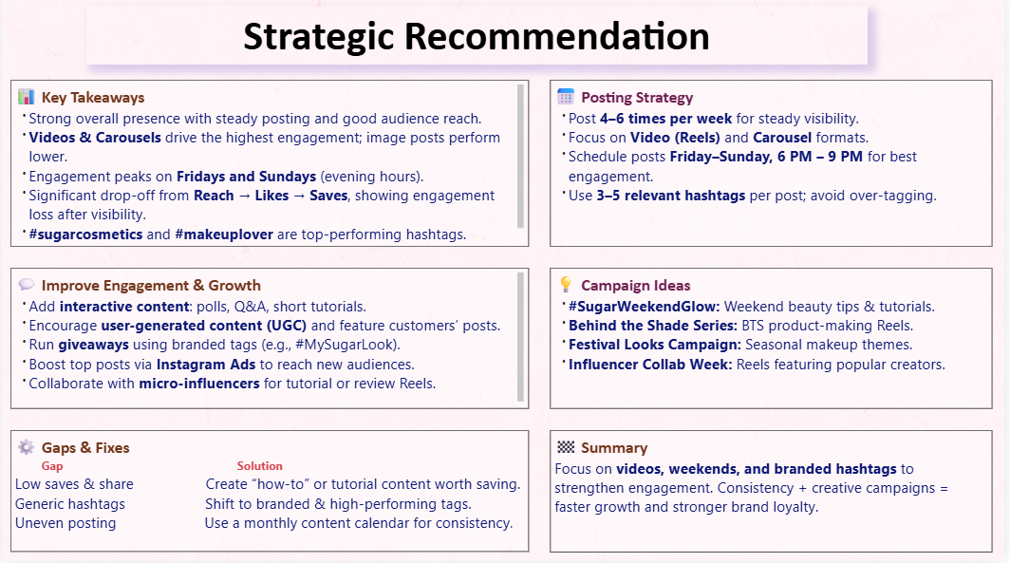
Recommendations & Strategy | Business Suggestions

Slide 10
THANK YOU

